Slide 1
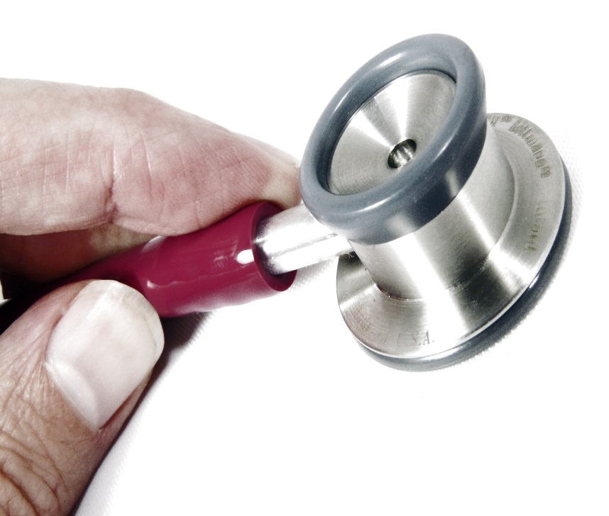
Professionalism in medicine
Madawa Chandratilake

Slide 2
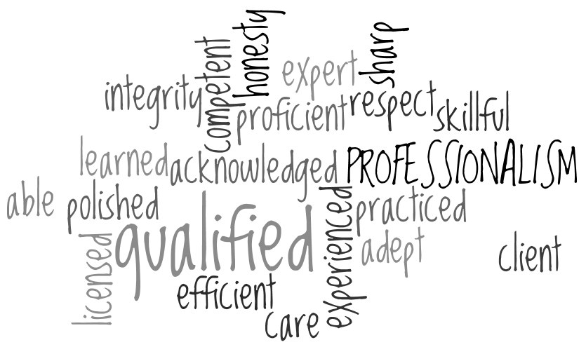

What is professionalism?

Slide 3
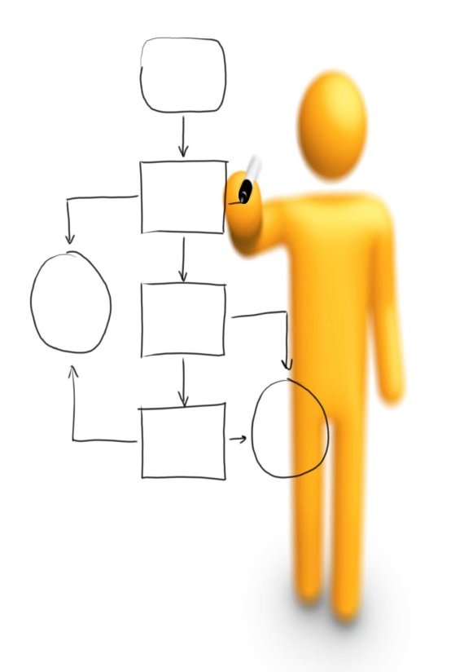
Individual Task
What do you understand by the term ‘professionalism’?
What are its attributes?

Slide 4
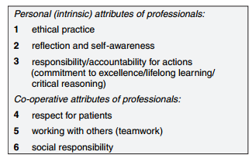
(Hilton and Slotnick 2005)

Slide 5
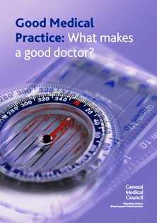
GENERAL MEDICAL COUNCIL - UK
‘Good doctors’ make the care of their patients their first concern: they are competent, keep their knowledge and skills up to date, establish and maintain good relationships with patients and colleagues, are honest and trustworthy, and act with integrity.
(GMC Good Medical Practice 2009)

Slide 6
GENERAL MEDICAL COUNCIL - UK
Key elements
Behaving according to ethical and legal principles
Reflecting, learning and teaching others
Learning and working effectively within a multi-professional team
Protecting patients and improving care
(GMC, Tomorrow’s Doctors 2009)

Slide 7

AMERICAN BOARD OF INTERNAL MEDICINE
Professionalism is the basis of medicine’s contract with society.
(ABIM 2002)

Slide 8
AMERICAN BOARD OF INTERNAL MEDICINE
Key elements:
Patient welfare: a dedication to serve the interest of the patient
Patient autonomy: empowering patients to make informed decisions about their treatment
Social justice: actively promoting justice in the health care system

Slide 9
Summary
Medical professionalism signifies a set of values, behaviours, and relationships that underpins the trust the public has in doctors.
(RCP, UK 2005)

Slide 10
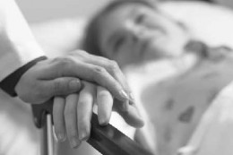


The public expectations (Chandratilake et al 2010)
Clinicianship:
Doctor’s relationship with patients
e.g. Good communication, Patient autonomy
Workmanship:
Doctor’s relationship with co-workers
e.g. Accountability, Reflective practice
Citizenship:
Doctor’s social behaviour
e.g. Law abiding behaviour, Social responsibility

Slide 11

Is the definition of professionalism universal and static?
Professionalism is a changing concept
Socially constructed
Sensitive to cultural backgrounds
Socio-economical changes

Slide 12

Cultural differences
Explainable by cultural theories

Slide 13

Cultural theories
Help us understand the differences
Do not promote prejudices against any cultural group
Notes:
These theories do not attempt to make us prejudiced against any cultural groups, i.e. they highlight the differences but do not say that one is better than the other.

Slide 14
e.g. Cultural dimensions theory (Hofstede 2010)
Western cultures (UK, Europe and North America) | Eastern cultures (Arabic Gulf region, Asian subcontinent )
Individualists | Collectivists
Unequal power distribution in-between social strata is unacceptable | Unequal power distribution in-between social strata is acceptable
Notes:
According to the cultural dimensions theory, the dynamics of a particular society may be influenced by several cultural dimensions. Some of the dimensions appeared to be relevant in understanding professionalism.
Individualists: tend to encourage the development and display of individual personalities, value independence, and are therefore comparatively less socially-oriented
Collectivists: tends to value membership of a long-term group and therefore social orientation is comparatively high
Deal with uncertainty: tend to deal with uncertainty; tend to prefer fewer rules and guidelines, enjoy informal activities, and are therefore open to diverse opinions
Avoid uncertainty: tend to value strict rules and formal activities and are therefore less tolerant of dissent
Short-term oriented: tend to encourage the seeking of immediate stability
Long-term oriented: tend to value thrift and actions and attitudes that affect the future
Unequal power distribution in between social strata is unacceptable: Expect equal power to all members of the society, less powerful members of society tend not to accept and expect that power is distributed unequally
Unequal power distribution in between social strata is acceptable: Expect unequal power between different social classes, less powerful members of society tend to accept and expect that power is distributed unequally

Slide 15

Empirical evidence for cultural differences (e.g. Chandratilake et al 2012)
Core areas of professionalism
– universally accepted
e.g. ethical practice
Important differences
– explainable by socio-cultural
differences
e.g. Confidence – West versus East
Counter-cultural attributes
– to overcome cultural barriers
e.g. Punctuality for Asian doctors

Slide 16

Response to socio-economic changes

Slide 17

Examples of chronological changes (Sox 2007)
4th century B.C. – Hippocratic era
→ Noble identity for the profession
19th century – Industrial revolution
Research interest
20th century
Commercialisation
21st century
→ Patient-centredness

Slide 18
‘Old’ Professionalism |  | ‘New’ Professionalism
Detachment |  | Empathy
Paternalism |  | Emotional Engagement
Restricted communication with patients |  | Open Communication
 |  | Patient-centeredness
Medical beneficence as the most prominent ethical principle |  | Patient autonomy as the most prominent ethical principle
Borgstrom et al. 2010

Slide 19

Patient-centredness
What do you think about the following attributes of professionalism?
Empathy
Patient’s autonomy
Accountability
Collegiality
Multidisciplinary teamwork

Slide 20

What do you anticipate as the next paradigm change in professionalism?

Slide 21

Why do we bother about professionalism?

Slide 22
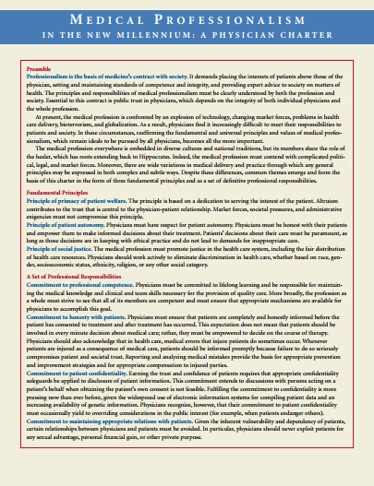
A formal requirement
e.g. ‘Good Medical Practice’ by the GMC, Physicians’
charter by ABIM

Slide 23
A moral obligation
Fitness to practice medicine
The change of ‘definition’
(Parker 2006)
Physical and mental fitness, knowledge and skills
Clinical competence
+
professionalism

Slide 24

A moral obligation contd.
Professional lapses as students / trainees
Fitness to practice issues as practitioners
(Papadakis 2001)
Source: http://www.claydugas.com

Slide 25

The educational impact
Almost all aspects of
professionalism are educable
(Cruess & Cruess 1997; Hodges et al 2011)
Assessment drives learning
(Epstein 2007)

Slide 26

What do you think are the key challenges of fostering professionalism?

Slide 27
The goal of professionalism education
Post-
conventional
Conventional
Civilisation of the profession
Pre-conventional
Stages of moral development (after Kohlberg 1969)

Slide 28

Teaching / learning
Professionalism:
learnt through role models
transmitted through workplace culture
→ hidden curriculum
→ Reflection and reflective practice

Slide 29
Fourth year Sri Lankan medical students on role models
“…there is another incident with regard to the same (profession) …….. there is an actress, when she came, the consultant who never does a scan for a lay person, personally did the scan, and no one was allowed to come in and, actually we didn’t want such thing to happen....”
“Everyday, most of our seniors, not senior students, the consultants and other senior doctors, say that if you don’t study and pass the exam you’ll end up in a remote area. So, it makes us working in a remote area is very bad thing.”

Slide 30
“…..we have encountered one of the ******gist. It is a subspecialty. He always wants us to choose his specialty…he guided us there. That was extremely professional as a teacher because he did not give us ‘money’ as a goal. Even the fame of a consultant as a goal. But he want us to further in ******logy. So, that was very much had a positive impact on us in comparison to what some consultants did (giving the reason of choosing the specialty as ability to earn 150 thousand a day)”

Slide 31

Learning processes in a hidden curriculum (Lempp and Steele, 2004)
Loss of idealism
Adoption of “ritualised” professional identity
Emotional neutralisation
Change of ethical identity
Acceptance of hierarchy
Learning of the less formal aspects of “good doctoring”

Slide 32

Assessment
Demonstrating professional behaviours versus becoming a professional
→ More emphasis of assessment for learning than assessment of learning

Slide 33

Take-home Messages
‘Professionalism’ is a changing concept (dynamic).
We create its meaning and it is sensitive to socio-economic and cultural factors.
Both the public and professionals’ perspectives are important.
Reflection and reflective practice is a cornerstone of fostering professionalism.
Assessment for learning appeared to be more effective.

Slide 34
THANK YOU

Slide 35
References
ABIM Foundation (2002). Medical Professionalism in the New Millennium: A Physician Charter. Annals of Internal Medicine, 136(3):243.
Borgstrom, E., S. Cohn, et al. (2010). Medical professionalism: conflicting values for tomorrow's doctors. Journal of General Internal Medicine 25(12): 1330-1336.
Chandratilake, M., S. McAleer, et al. (2012). Cultural similarities and differences in medical professionalism: a multi-region study. Medical Education 46(3): 257-266.
Cruess RL, Cruess SR. (1997). Teaching medicine as a profession in the service of healing. Academic Medicine 72:941-52.
Epstein RM. (2007). Assessment in medical education. The New England Journal of Medicine 356:387-96.

Slide 36
GMC (2009). Tomorrow's doctors. London General Medical Council 25 - 29.
Hilton S & Slotnick H (2005) Proto-professionalism: how professionalisation occurs across the continuum of medical education. Medical Education 39(1): 58 – 65.
Hodges BD, Ginsburg S, Cruess R, Cruess S, Delport R, Hafferty F, et al. (2011) Assessment of professionalism: recommendations from the Ottawa 2010 Conference. Medical Teacher 33:354-63.
Hofstede, G., G. J. Hofstede, et al. (2010). Culture and organisations; software of the mind. New York, McGraw Hill.
Huddle, T. S. (2005). Teaching professionalism: Is medical morality a competency? Academic Medicine 80(10): 885 - 891.
Kohlberg, L. (1969). Stage and sequence: The cognitive developmental approach to socialisation. In D. A. Goslin (Ed.), Handbook of socialisation theory and research (pp. 347–480). Chicago: Rand McNally.

Slide 37
Papadakis, A. M., H. Loeser, et al. (2001). Early detection of evaluation of professionalism deficiencies in medical students: one school's approach. Academic Medicine 76(11): 1100 - 1106.
Parker M. (2006). Assessing professionalism: theory and practice. Medical Teacher 28:399-403.
RCP (2005). Doctors in society: medical professionalism in a changing world. London, Royal College of Physicians.
Sox, C. H. (2007). The ethical foundations of professionalism; a sociologic history. Chest 131(5): 1532 - 1540.

Slide 38
What are your questions?
madawachandratilake@gmail.com
mnchandratilake@kln.ac.lk

